Slide 1












Slide 2
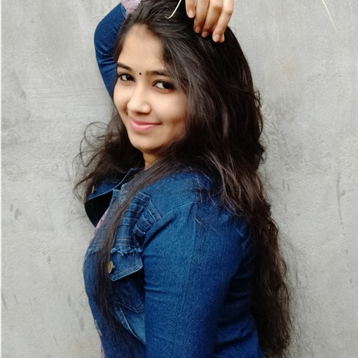

Slide 4
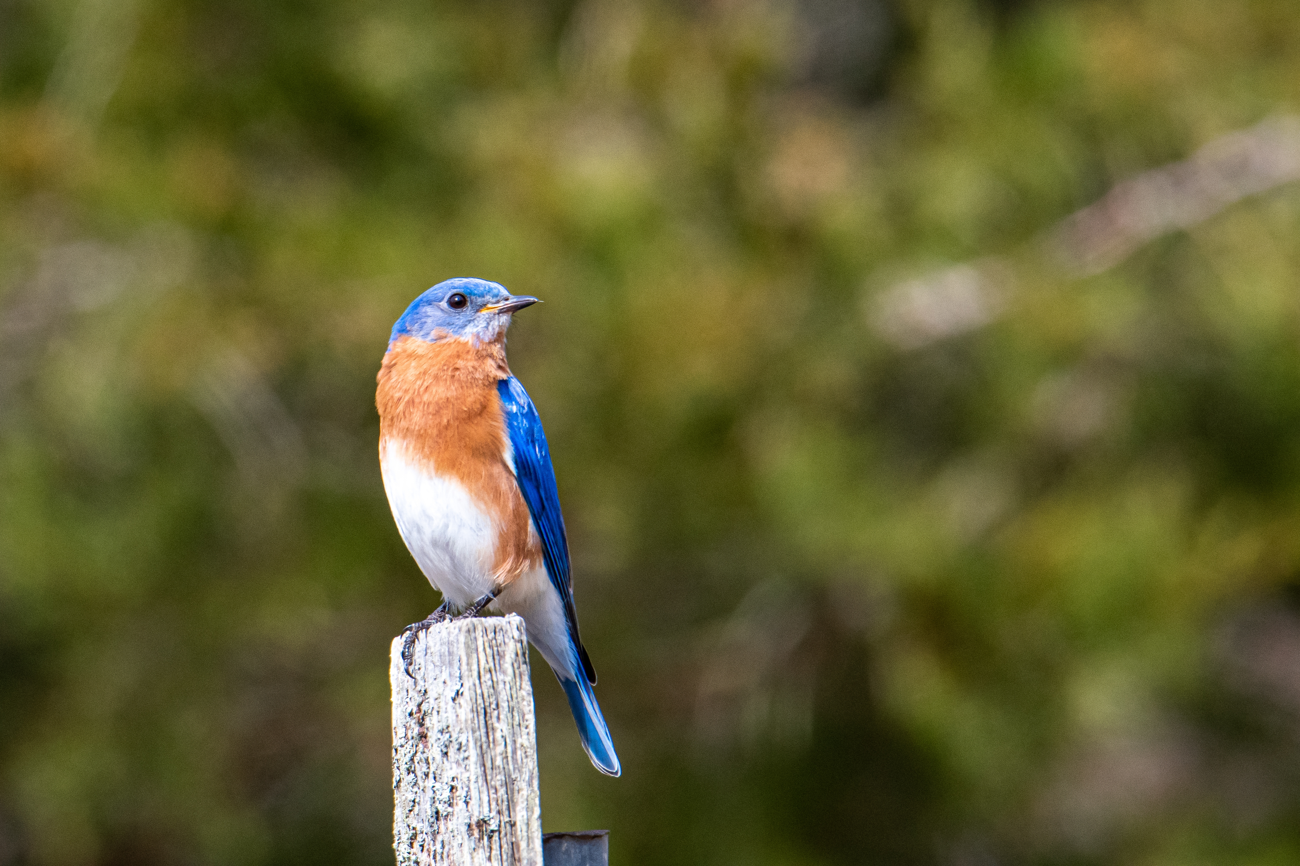

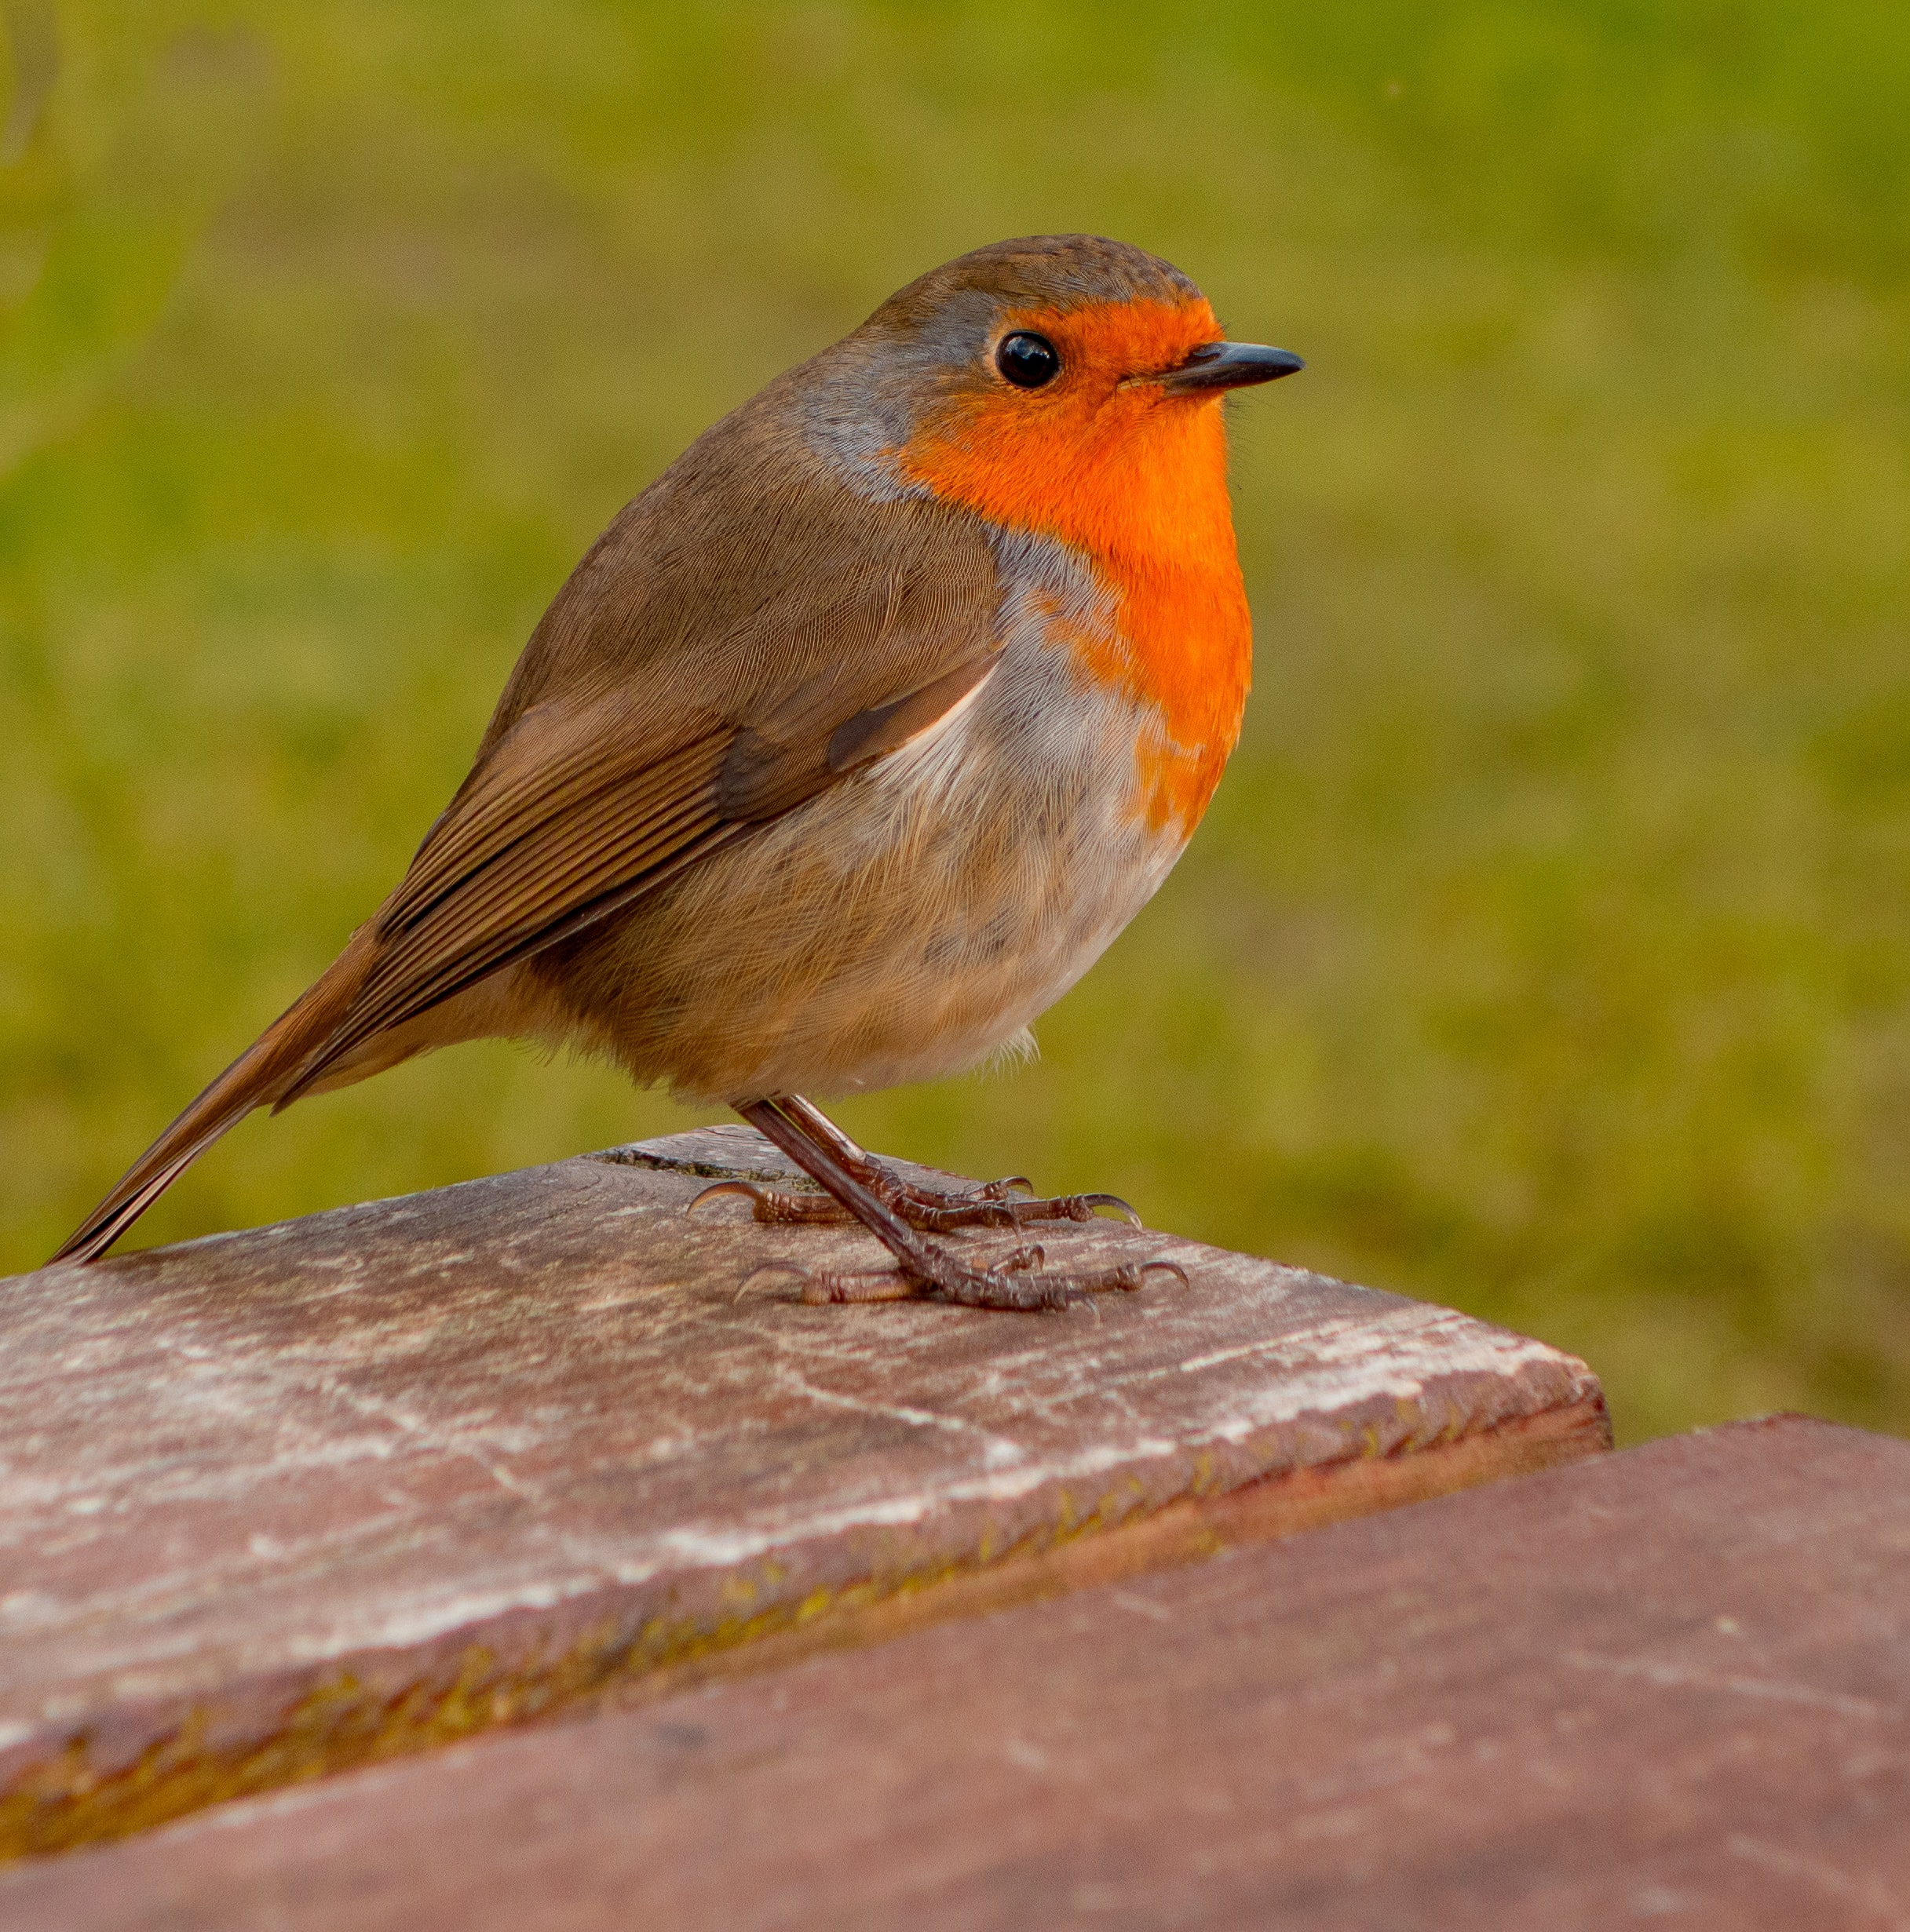




Slide 6


Slide 7
Heading 1
Heading 2
Heading 3
Heading 4
text
text
text
text

Slide 8



Slide 9



Slide 10





1
Heading 5
Heading 1
Write E-mail
Write name
5
2
Heading 2
Heading 4
Write Ph no
Write Address
4
3
Heading 3
Write BOD

Slide 11


Slide 12





Slide 13
PRANGYA
SMRUTI RANJAN

Slide 16
BYY………….

Slide 17


Riya’ss
Album…s

Slide 18
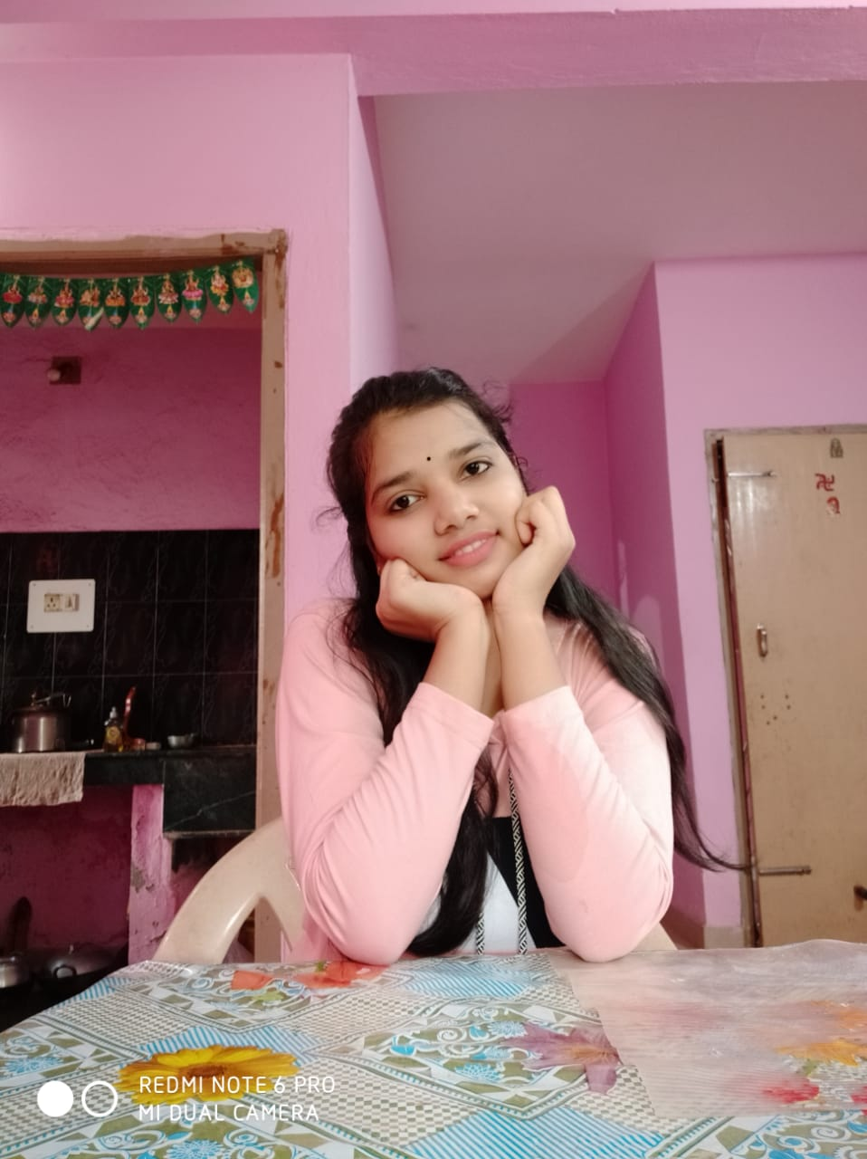


Slide 19
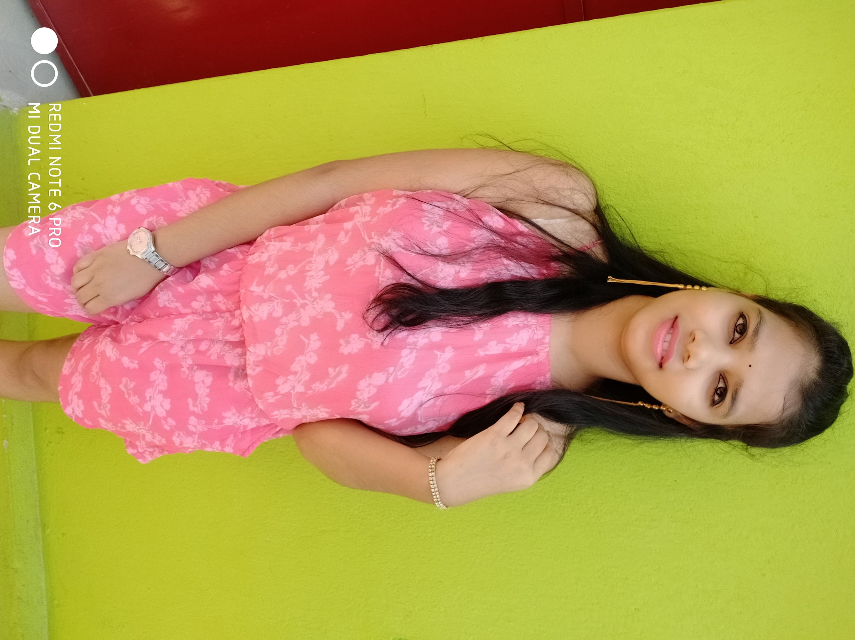
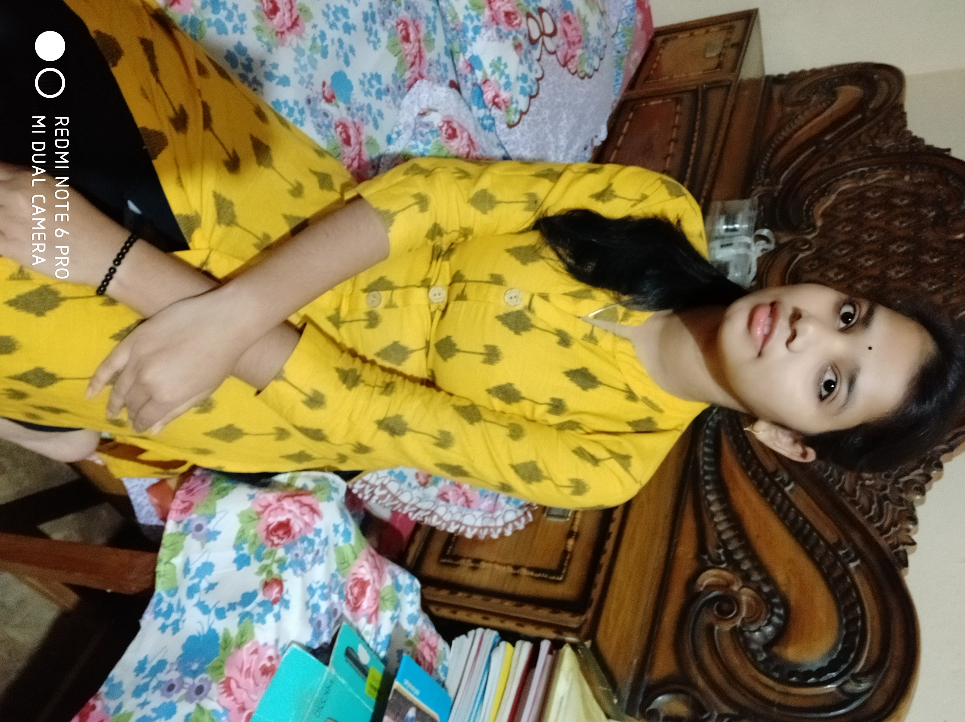



Slide 20








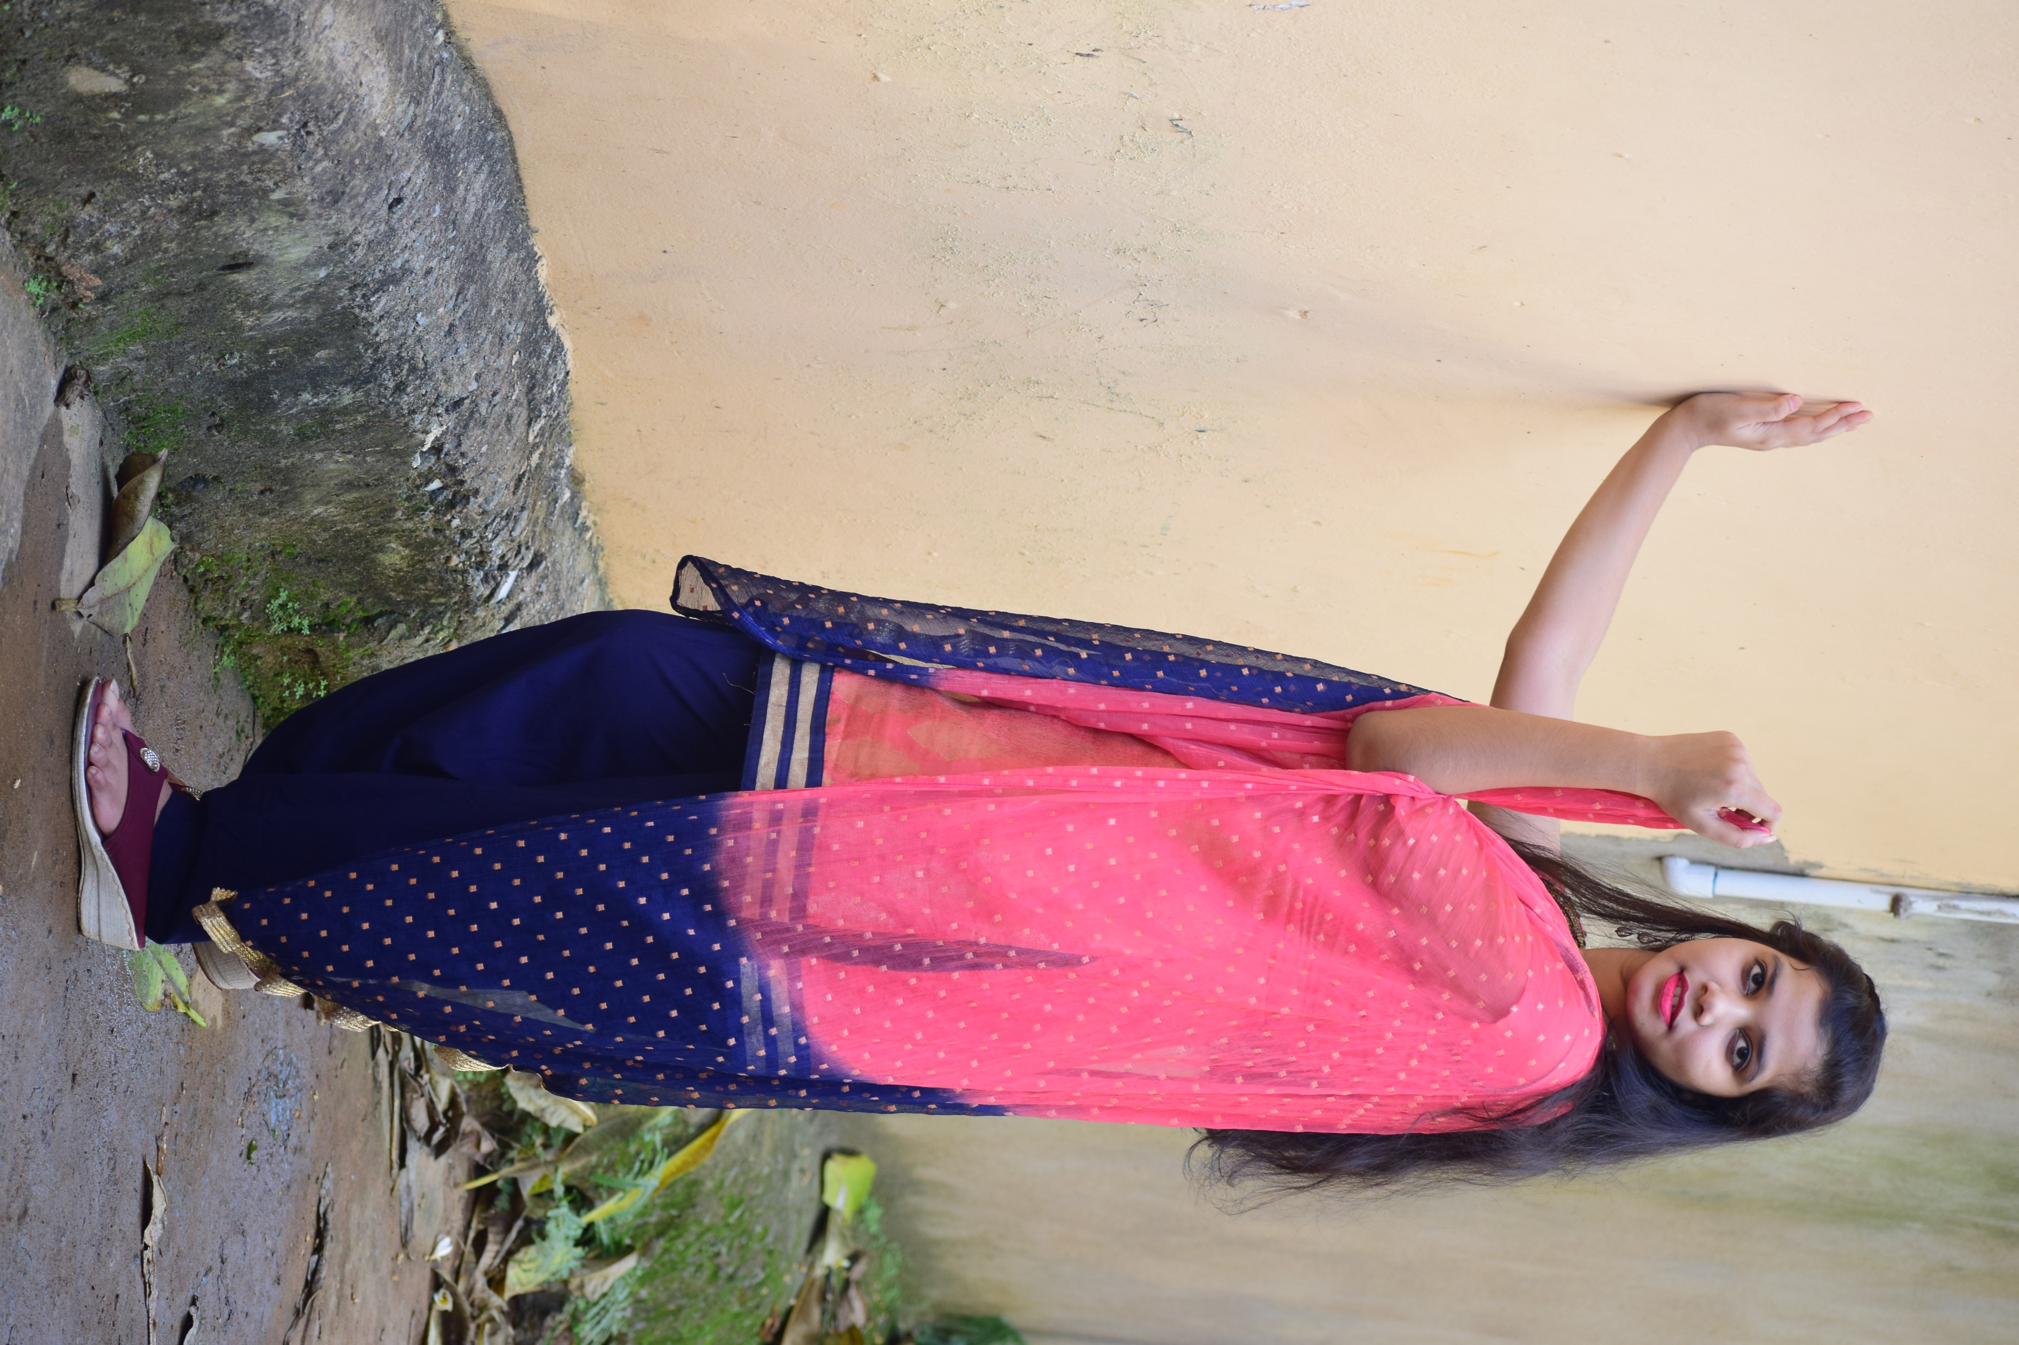




Slide 21

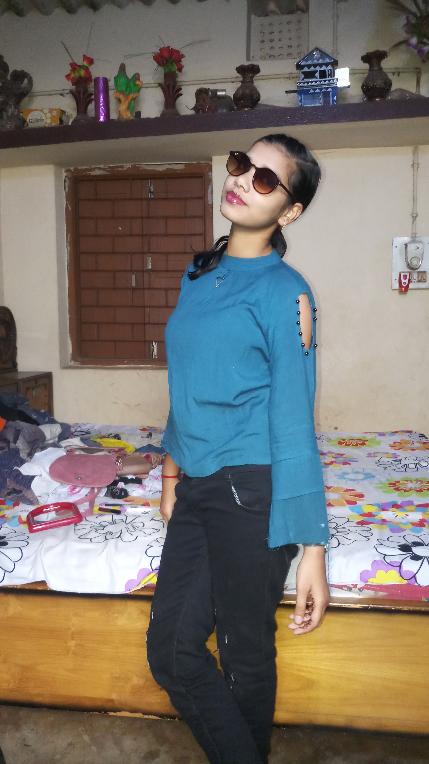

Slide 22




Thanks…

